Slide 1
Complex Data explorer CODEX
MGSS MMR
Jack Lightholder
9/10/19
Josh Rodriguez, Rob Tapella, Lukas Mandrake

Slide 2
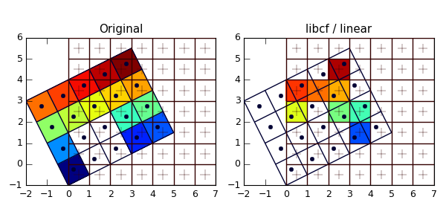
Complex Data Explorer - CODEX
See What’s In The Data
Objective:
Develop automated tool using machine learning techniques to quickly scan mission science and engineering data to reveal structures and problems
Can flag anomalies and/or select best subset of data for later, more detailed analysis
Motivation:
Ops, engineering, science datasets are large & complex
Time-critical need to see data contents & quality
Data problems not immediately noticed since buried in data
Custom data monitors limited; much analysis still manual
Alignment with System Strategic Plan
Addresses following AMMOS System Strategic goals:
Reduce mission operations cost and risk
Fast data problem and anomaly identification
Leverage technological advances in computing
Broadens AMMOS to Support Future Missions
Supports increased data volumes and data rate
Addresses Elements of Systems Strategic Roadmap
High performance queries (s/c data) enabling support for faster operational decisions
System applicable to operations, science data analysis, engineering data analysis and multiple mission phases
Mission Relevance
Users: ☐ Existing Missions ☐ New Missions
List Missions/users: All planetary/Earth missions with large amounts of data downlink (Europa, M2020, SWOT, OCO3, etc.)
Anomaly Detection
Re-grid
Co-locate
Geospatial
Population Explanation
Advanced
Correlation
Linked
Selection
X
X
Benefits
Risk Reduction: Rapidly recognize problems in data
Missing values, unexpected correlations
Changes in data relationships, bi-modality
Identify multiple populations: require statistics analysis
Isolate anomalies: for later study or omission
Search by example: “events like this” in entire dataset
Faster Research Results: Weeks of initial survey removed
Rigorous Stats: Understand incoming data distributions
Broad Applicability: All high-dimensional data consumers
Team
Jack Lightholder (PI / Machine Learning Development)
Lukas Mandrake (Vision)
Rob Tapella (UI/UX Design)
Josh Rodriguez (Front End Development)
Anton Kulikov (Front End Development)
Kit Petrie (Front End Development)
Patrick Kage (Front End Intern)
Alec Helbling (Front End Intern)

Slide 3
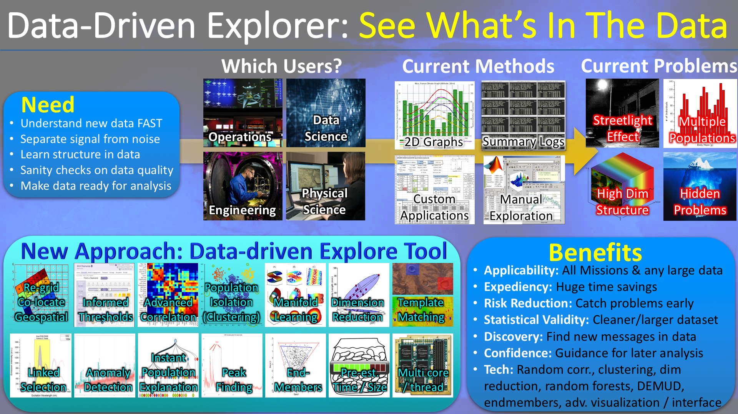
Technology Overview

Slide 4
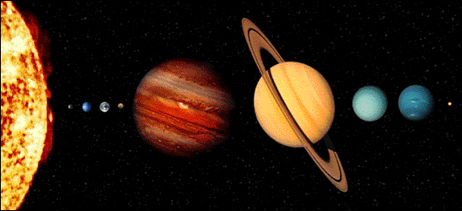
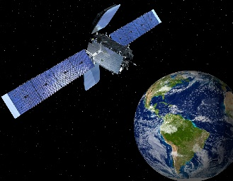
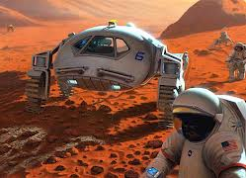
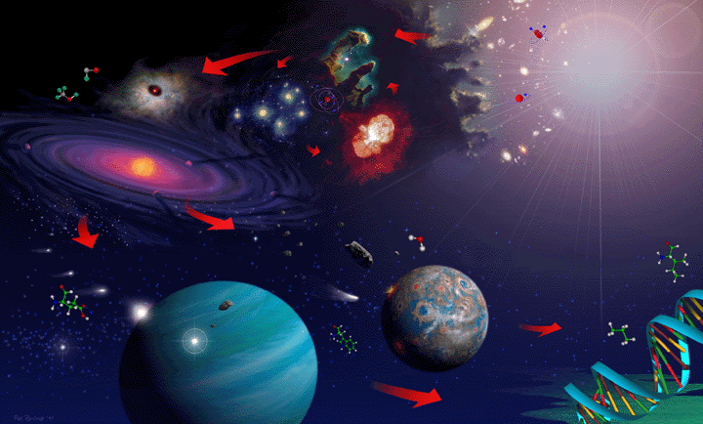
Data-Driven Explorer Mission Relevance
Relevance to Deep Space and Astrophysics Missions
Relevant to large class of Deep Space Missions. Any mission that could benefit from rapid exploration of instrument data to help identify anomalies, separate signal from noise, and find data correlations and structure (which contributes to improved analysis and science product generation).
Potential users include Europa, M2020, ARRM, MAVEN, Lunar Flashlight, etc.
Hyperspectral data especially relevant, common to Astrophysical missions
Relevance to other areas of NASA
Huge application for Earth Orbiters. Interest already expressed by OCO-2 and OCO-3. Can help address high data volume challenges of NISAR and SWOT.
Many missions could use today. Will target readiness for M2020 NISAR (2020) and SWOT (2021).
Magnitude of the Benefit
Significant reduction in data evaluation time – reduce from days to mins/hours
Early identification of anomalies – could save days of ops costs/time
Faster science product generation and analysis – save days of mission science analysis;
At least 50% reduction in time-to-anomaly-discovery and thorough data comparison/checkout functions (currently manual)
PLANETARY SCIENCE & ROBOTIC EXPLORATION*
EARTH SCIENCE
HUMAN EXPLORATION
ASTROPHYSICS*

Slide 5
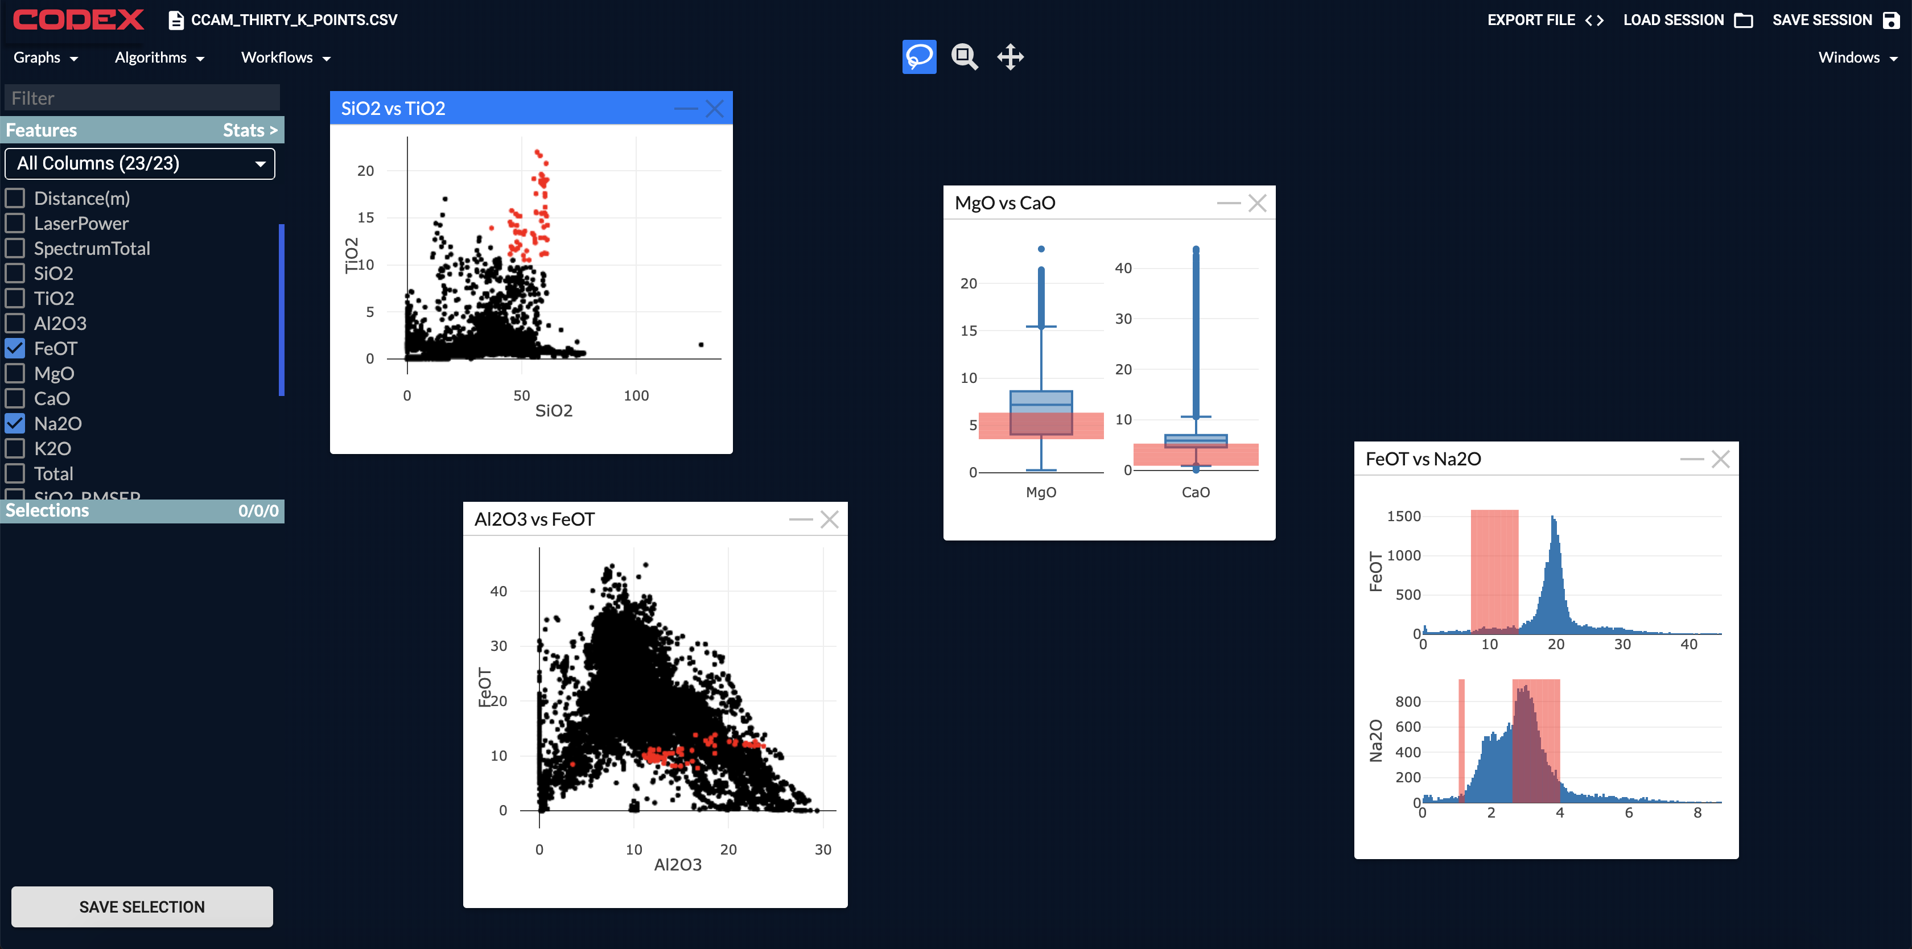
Technology Accomplishments
PLANETARY SCIENCE & ROBOTIC EXPLORATION*
EARTH SCIENCE
HUMAN EXPLORATION
Supporting the 7 most commonly used plot types for data exploration.
Circling data in one graph highlights it in all other graphs.
Allows for intuitive data exploration in more than 2 dimensions.
Desktop drag-and-drop layout for easy exploration and window rearrangement.
ASTROPHYSICS*

Slide 6
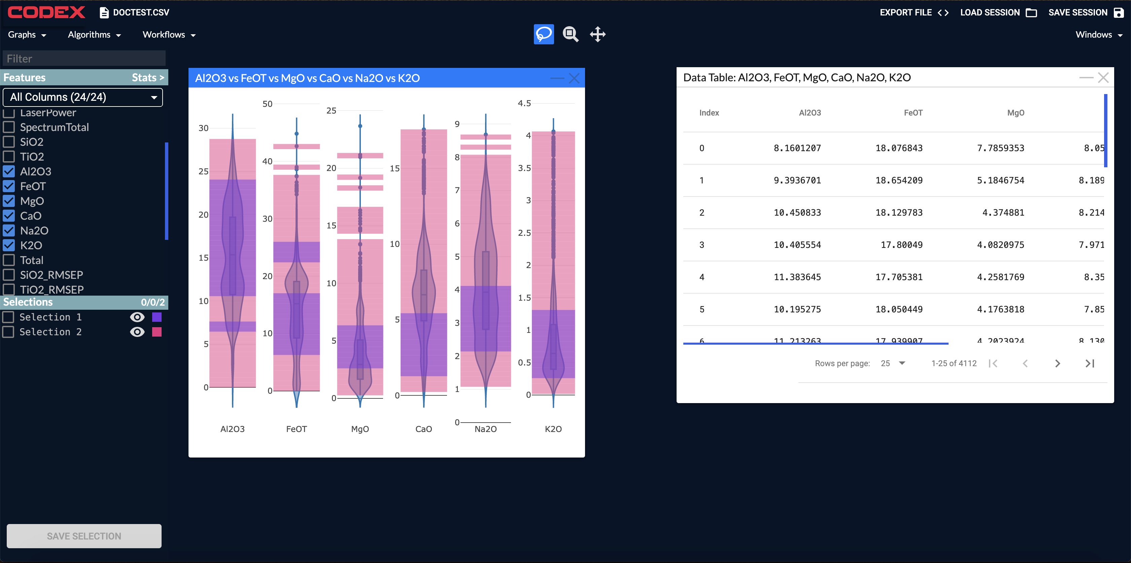
Technology Accomplishments
PLANETARY SCIENCE & ROBOTIC EXPLORATION*
EARTH SCIENCE
HUMAN EXPLORATION
Circled selections made on any plot type can be saved for later use.
Selections enable data filtration and isolation, which can be exported from CODEX
Python code to perform data filtration and isolation can also be exported, to be used on future files.
ASTROPHYSICS*

Slide 7
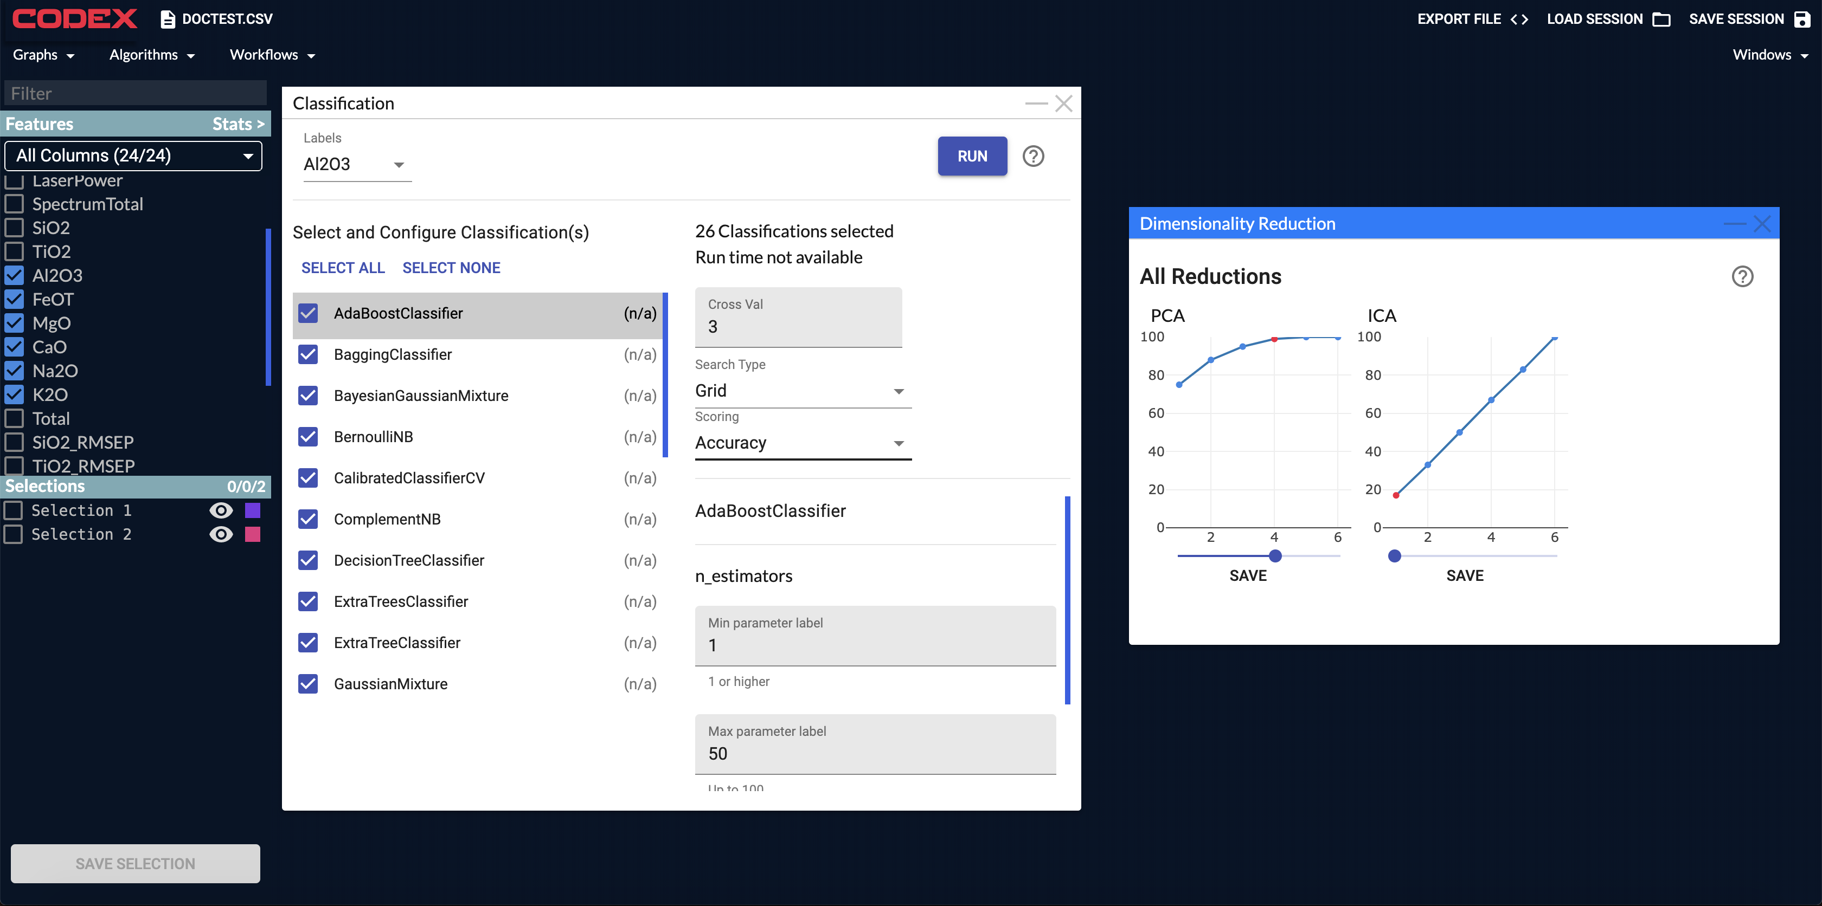
Technology Accomplishments
PLANETARY SCIENCE & ROBOTIC EXPLORATION*
EARTH SCIENCE
HUMAN EXPLORATION
Now supporting data classification and regression with all major algorithms.
All algorithms can be run and compared to find the optimal model for a given use-case.
Models can be saved with the entire CODEX session, for future use inside or outside CODEX.
ASTROPHYSICS*

Slide 8
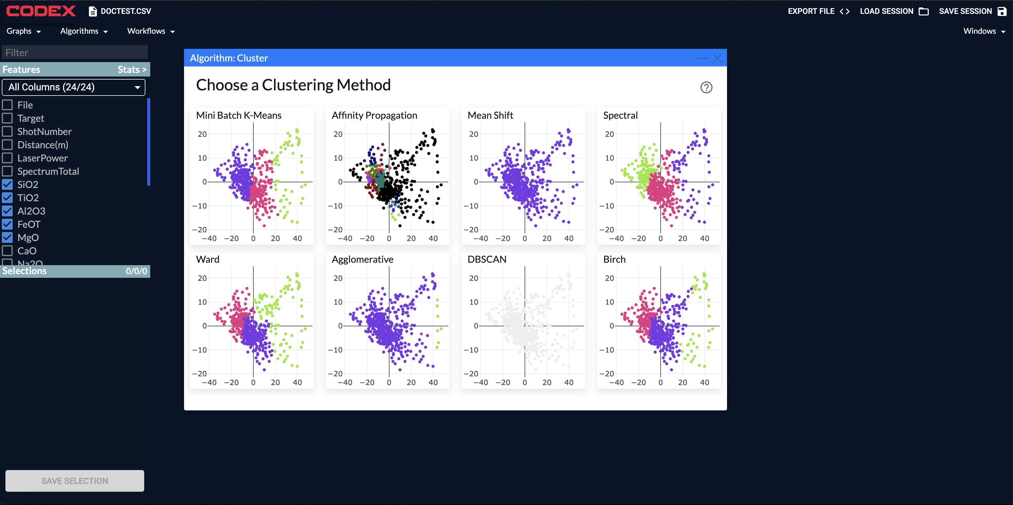
Technology Accomplishments
PLANETARY SCIENCE & ROBOTIC EXPLORATION*
EARTH SCIENCE
HUMAN EXPLORATION
The clustering algorithmic workflow allows users to explore many dimensions of data at once.
Outputs from each algorithm are displayed, along with explanations of how the algorithm works, to inform users on which algorithm they should select.
Clustering model outputs can be saved as selections and applied to another forms of analysis.
ASTROPHYSICS*

Slide 9
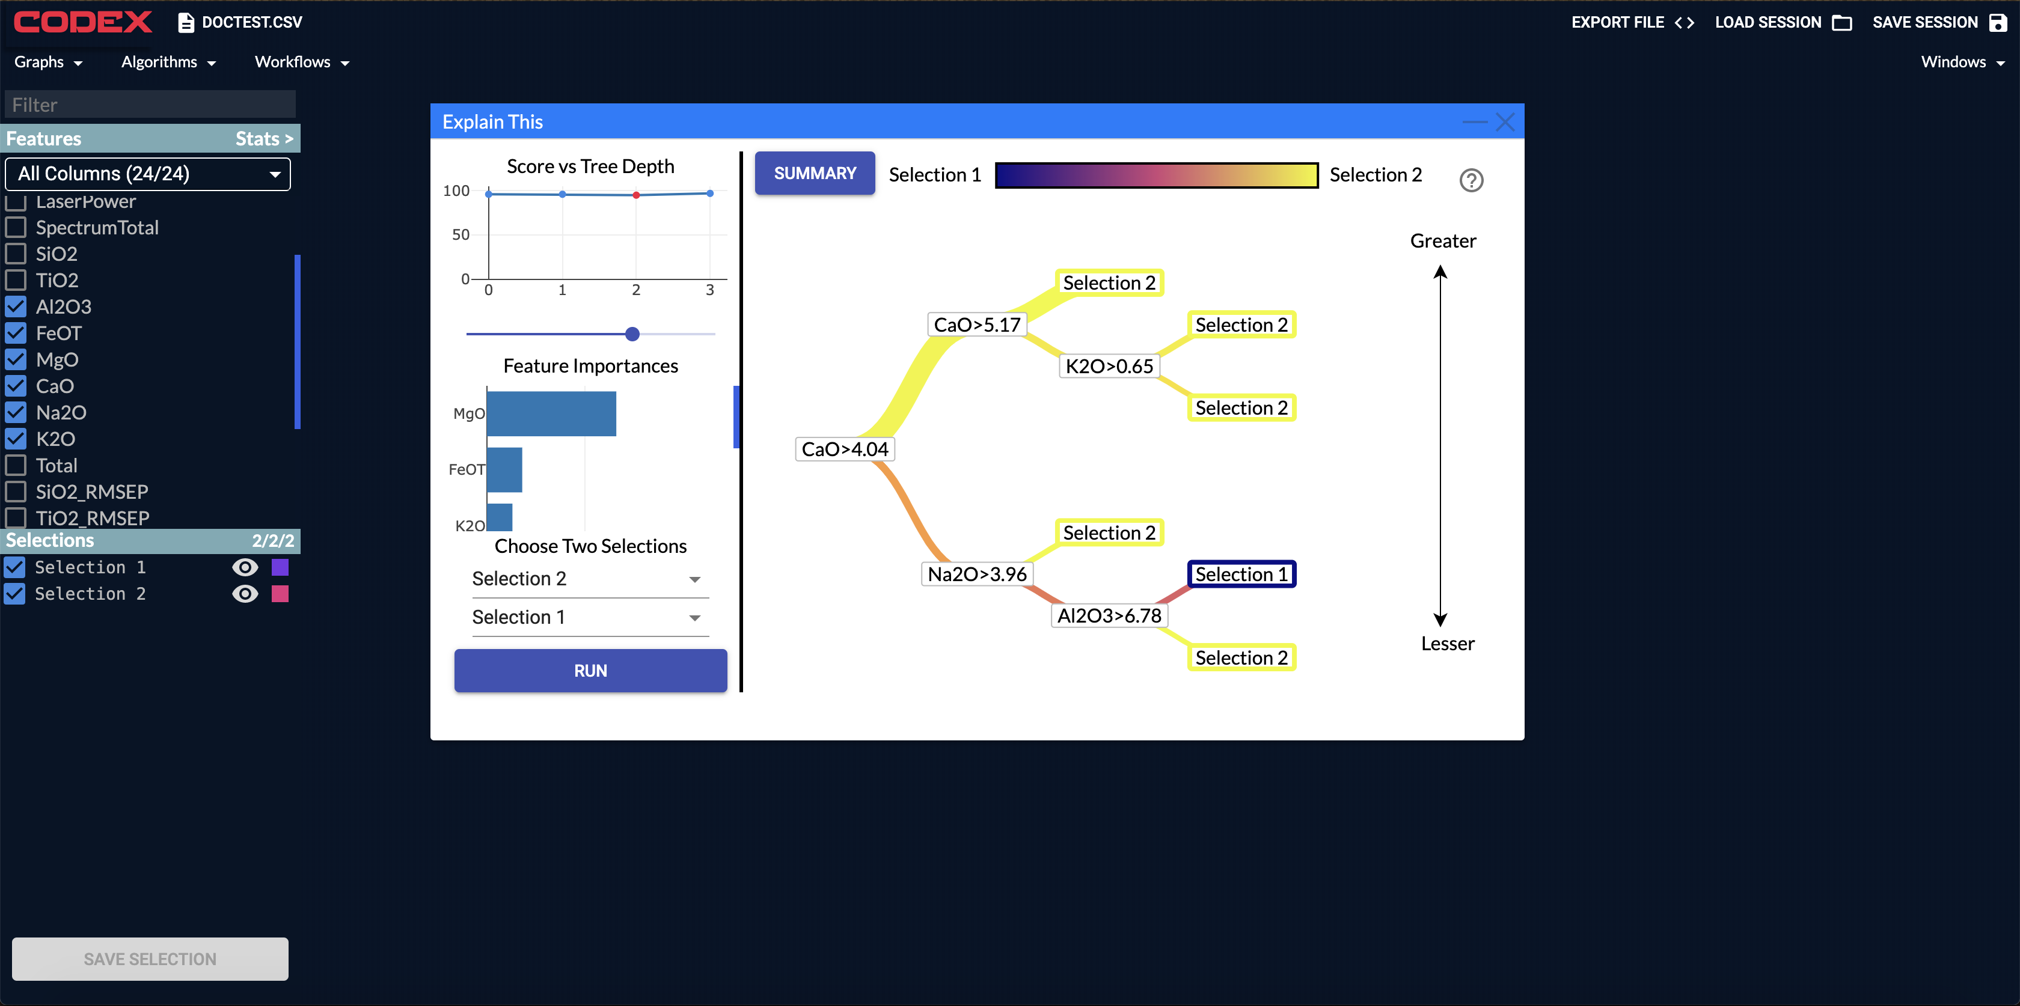
Technology Accomplishments
PLANETARY SCIENCE & ROBOTIC EXPLORATION*
EARTH SCIENCE
HUMAN EXPLORATION
The “Explain This” allows users to gain understanding into data phenomena in a guided workflow.
User identifies two data regions and requests can explanation of how they differ.
Using intuitive decision trees and histograms, CODEX defines for the user what makes the two populations of data unique.
ASTROPHYSICS*

Slide 10
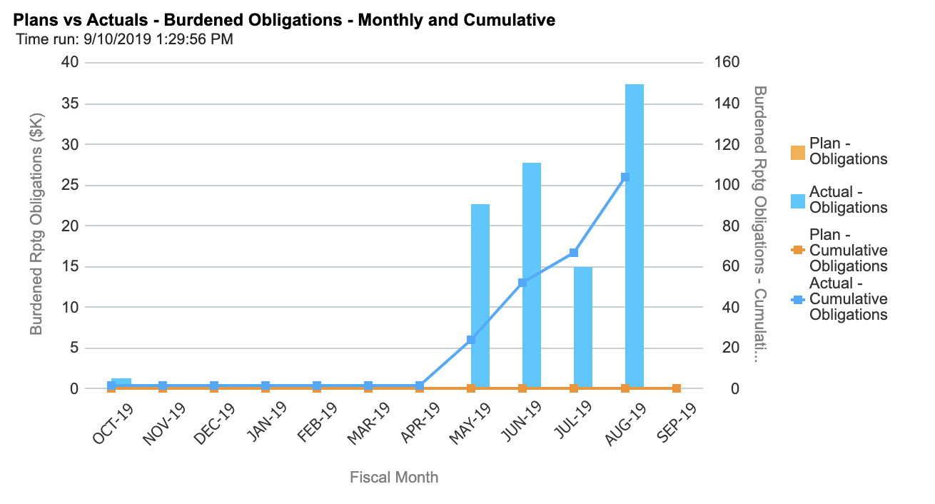
Financials
PLANETARY SCIENCE & ROBOTIC EXPLORATION*
EARTH SCIENCE
HUMAN EXPLORATION
Short of financial target due to workforce leaving JPL
Workforce has been recovered for FY20
All FY19 tasks completed through exceptional interns
ASTROPHYSICS*

Slide 11
Overview
Completed all FY19 tasks on schedule.
Exceptional interns identified for future summers, and potential full time employment post-graduation.
Full FY20 staffing identified.
Significant improvements to client stability and machine learning server depth.
Completed open sourcing process, first release coming soon.
Ongoing training/infusion work with ASTHROS balloon mission to use CODEX for primary data analysis tool.
PLANETARY SCIENCE & ROBOTIC EXPLORATION*
EARTH SCIENCE
HUMAN EXPLORATION
ASTROPHYSICS*

